Slide 1

GROUP 1
CAREER GUIDANCE
SYSTEM
YASVINIPPRIYAA S K – 2021506126
TEJASREE M S – 2021506113
RUDHRA Y – 2021506076

Slide 2

CONTENTS
Problem statement
Objectives
About our project
ER diagram
Snapshots of the project and the
database

Slide 3

3
PROBLEM
STATEMENT
To make students explore their area of interest
and choose the career of their choice and what
they love to do which will help them flourish
monetarily and help them in a longer run.

Slide 4
4
OBJECTIVES
• To enable a login platform for the user
• To let the user take the career guidance test once and
to store that result so that the user can view it in the
future
• To navigate the flow of subsequent questions based on
the answer provided by user to previous questions
• To create a warm ambience that promotes career
exploration and decision making
• Empowering young kinds with the apt guidance.

Slide 5

ABOUT OUR PROJECT

Slide 6
6
A career management system is a tool or platform that helps
individuals choose their career. Our project career management
system offers guidance on career planning and goal setting. It can be
useful for people at all stages of their careers, from those just starting
out to those looking to advance or make a career change however it
mainly focuses on students coming out of school.
Deciding on a career is an important process because it can have a
significant impact on future. A career is not just a job or a source of
income, but rather it is a long-term pursuit that will likely occupy a
significant portion of your life and play a major role in shaping identity
and sense of purpose. It's important to choose a career that aligns
with your values, interests, and skills, and that provides fulfillment and
satisfaction.

Slide 7
7
Choosing a career is also an important decision because it can
be difficult to change careers once you have invested time and
resources into a particular field. It's important to take the time to
research and consider your options before making a decision,
and to be open to seeking advice and guidance from others who
may have more experience or knowledge in this area.
Our system facilitates people to log in and take up a career
guidance test so end of the test they will be able to explore their
area of interest.

Slide 8
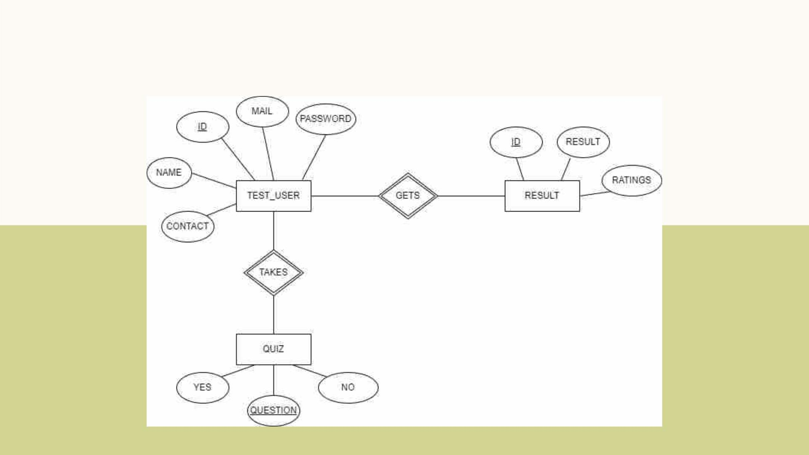
ER DIAGRAM
8

Slide 9
DEMO OF THE
PROCESS

Slide 10
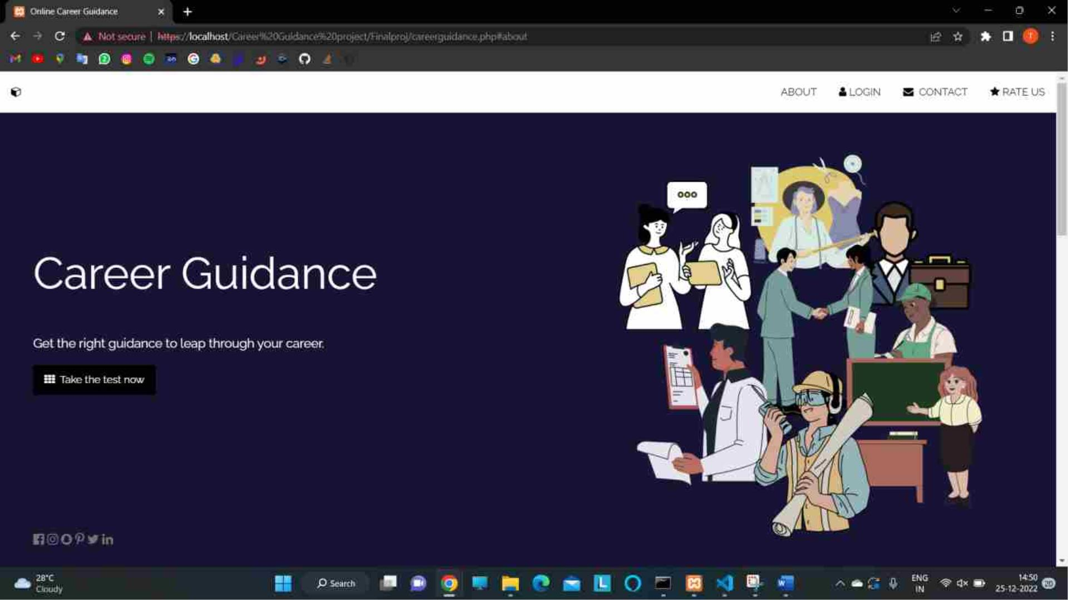

Slide 11
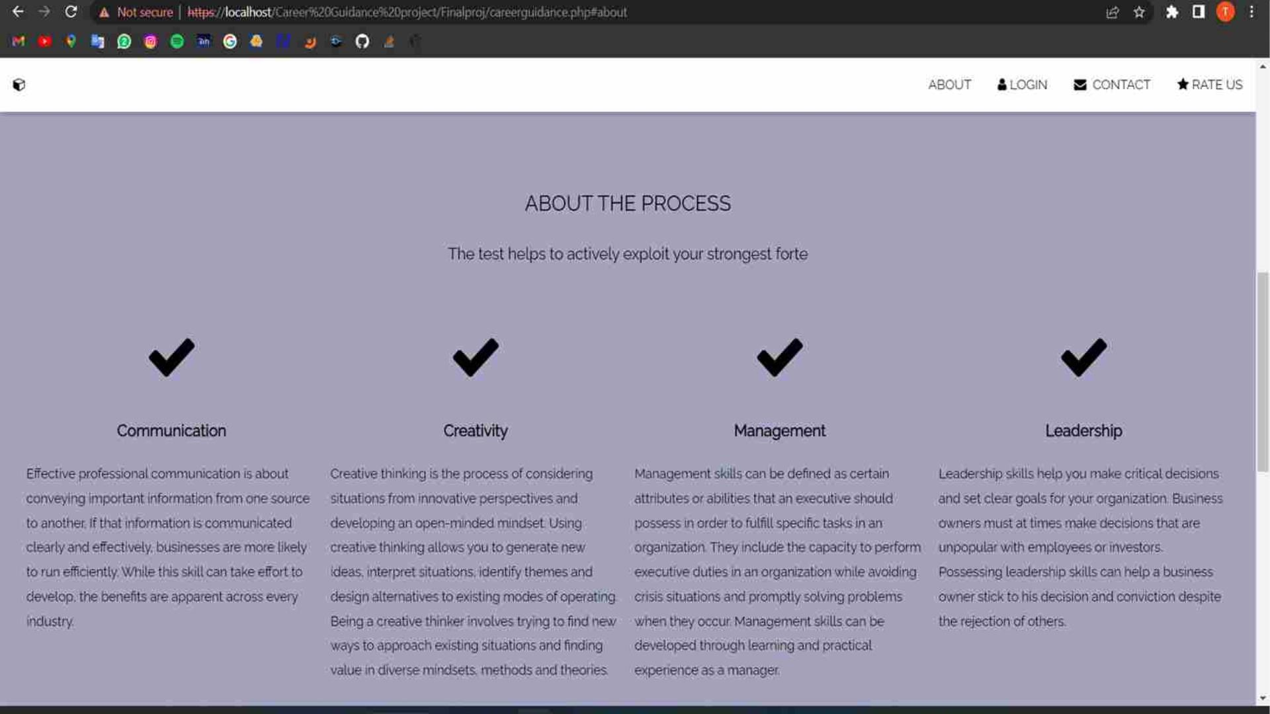
.
11

Slide 12
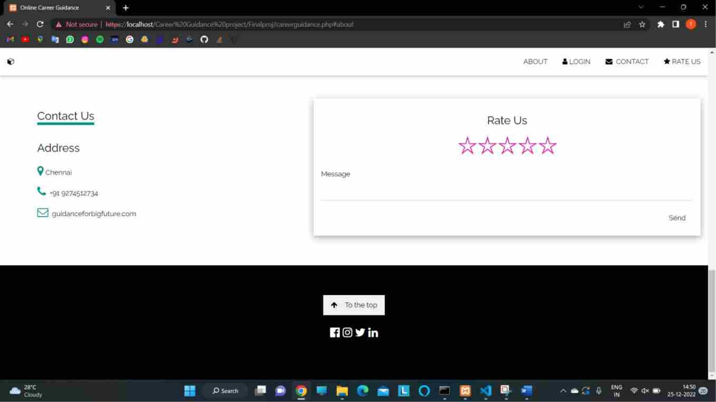

Slide 13
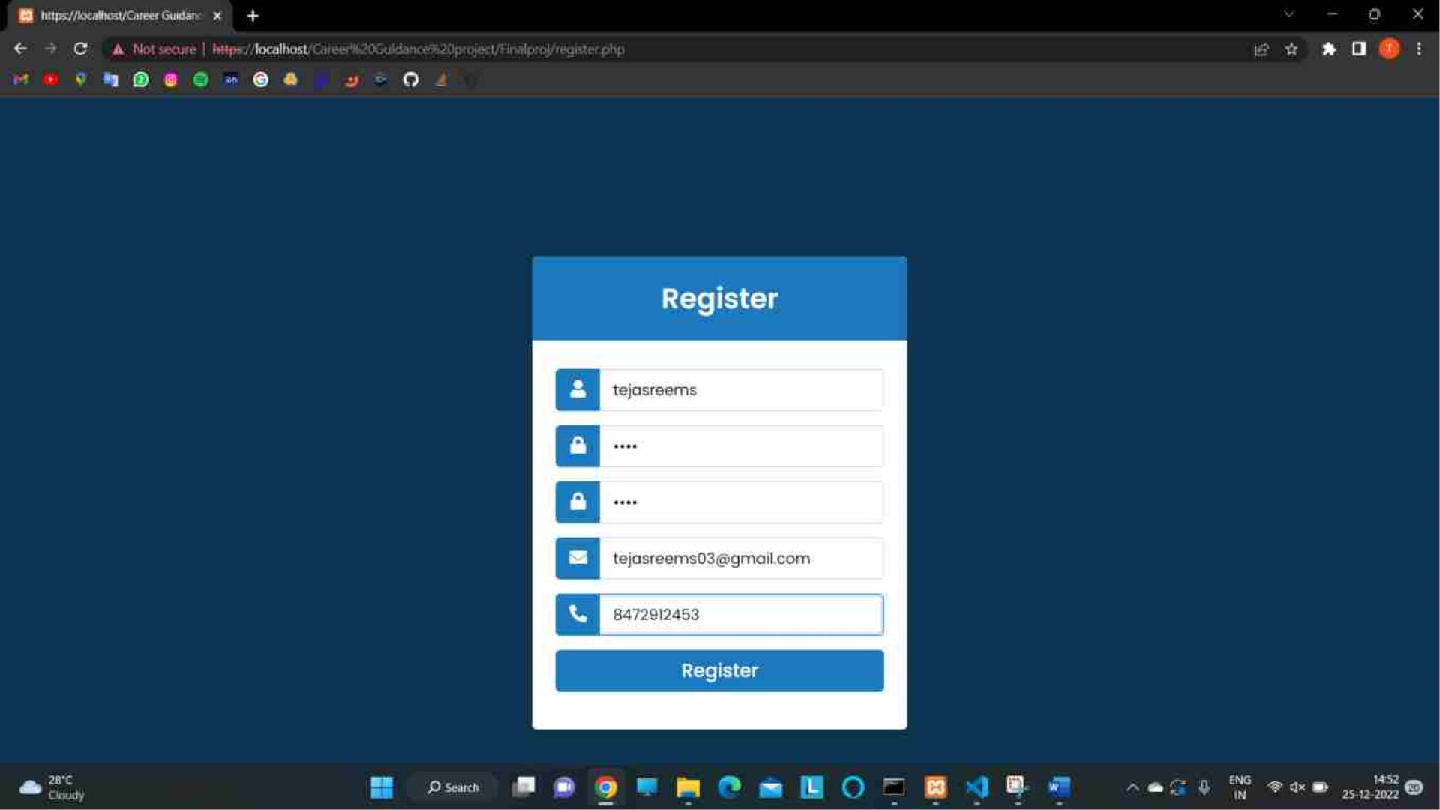

Slide 14


Slide 15
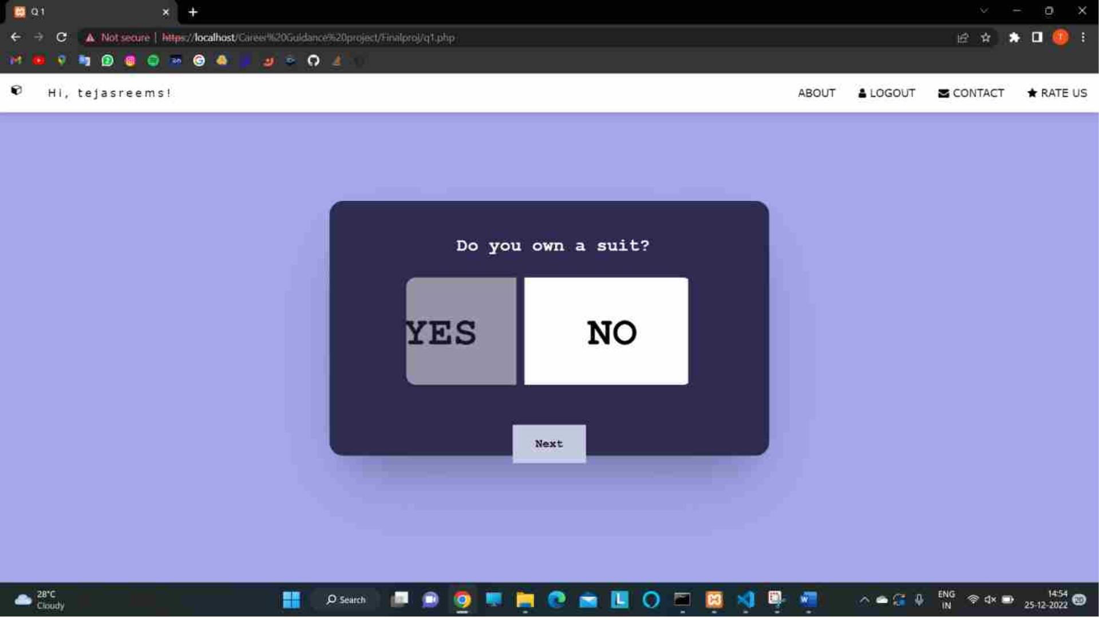

Slide 16
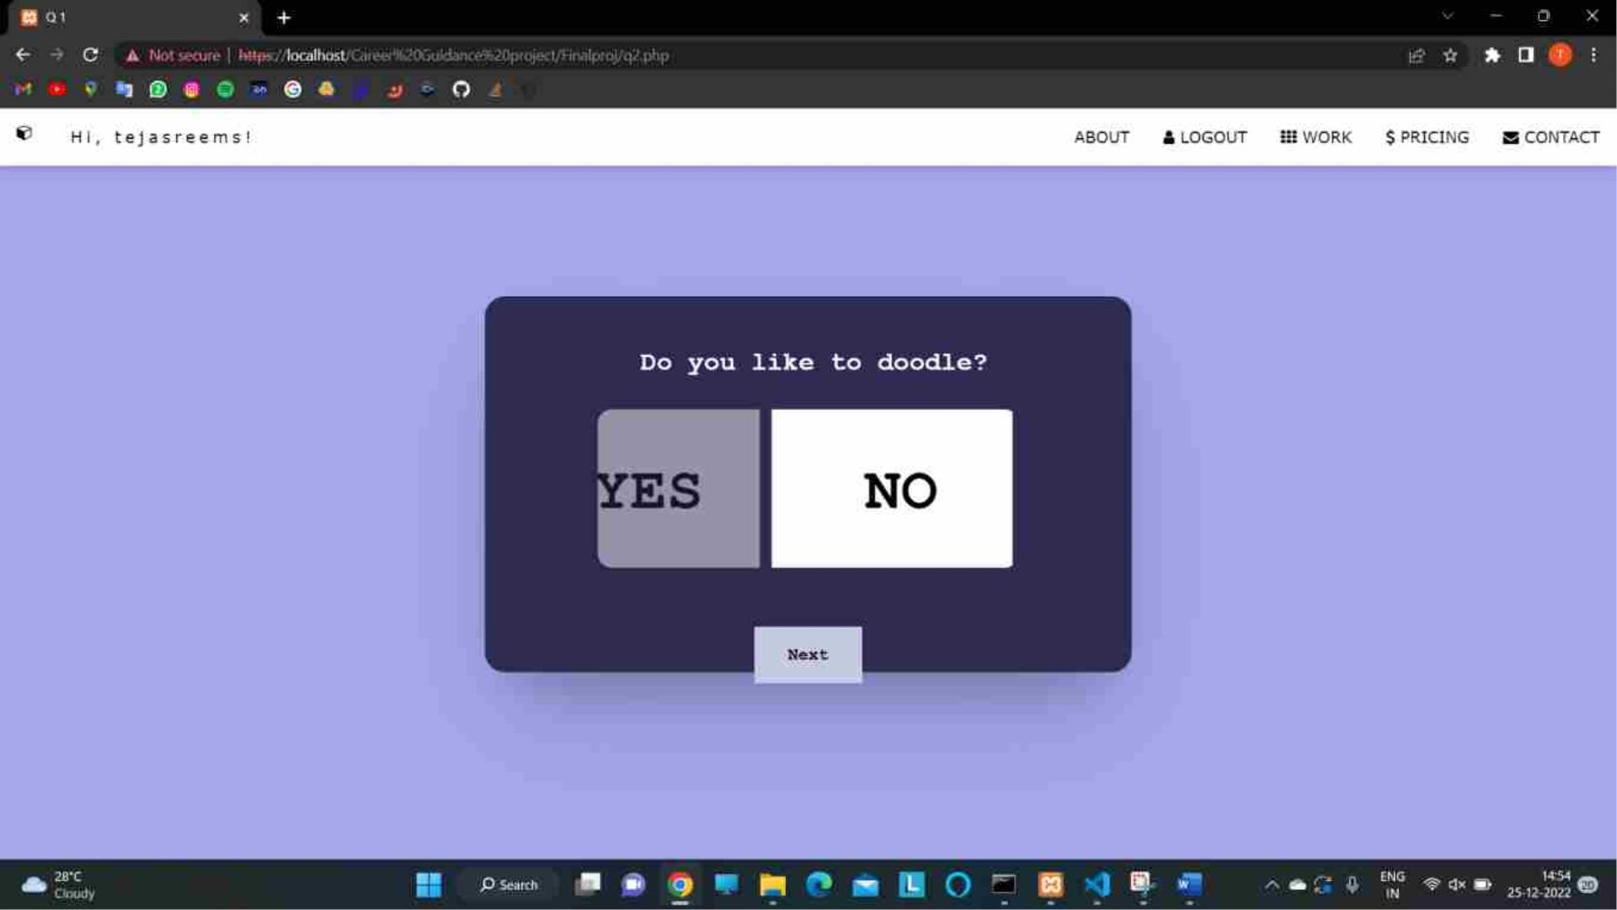

Slide 17
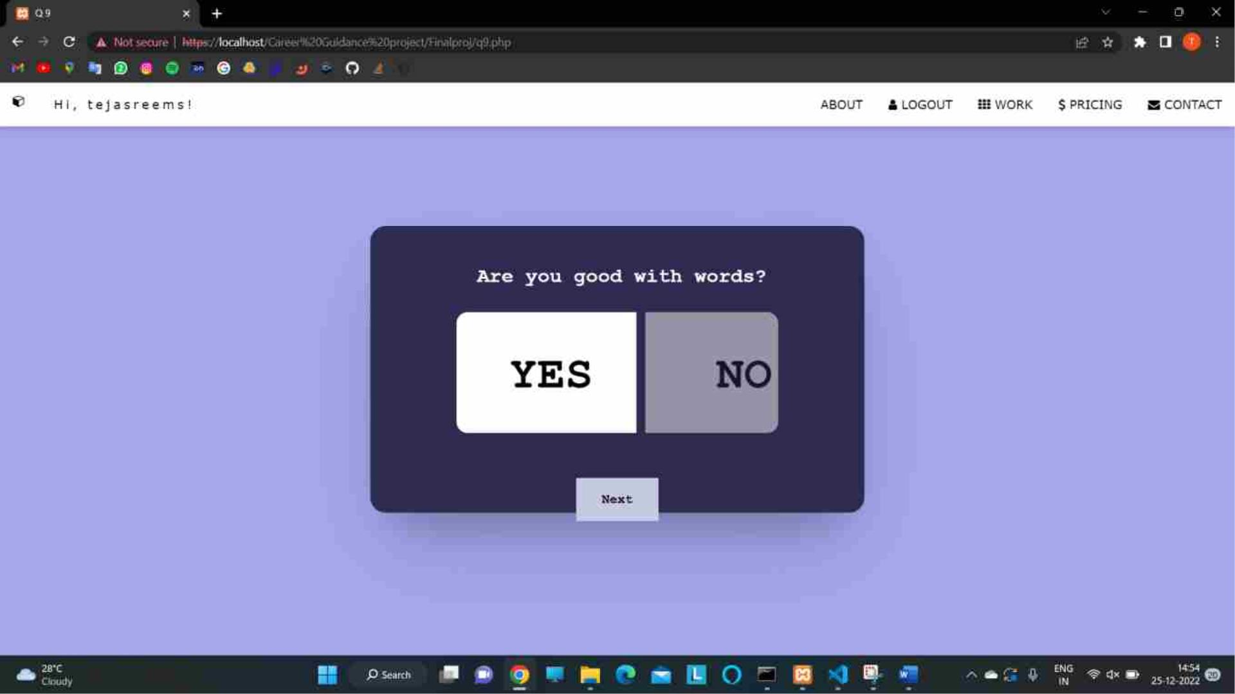

Slide 18


Slide 19


Slide 20
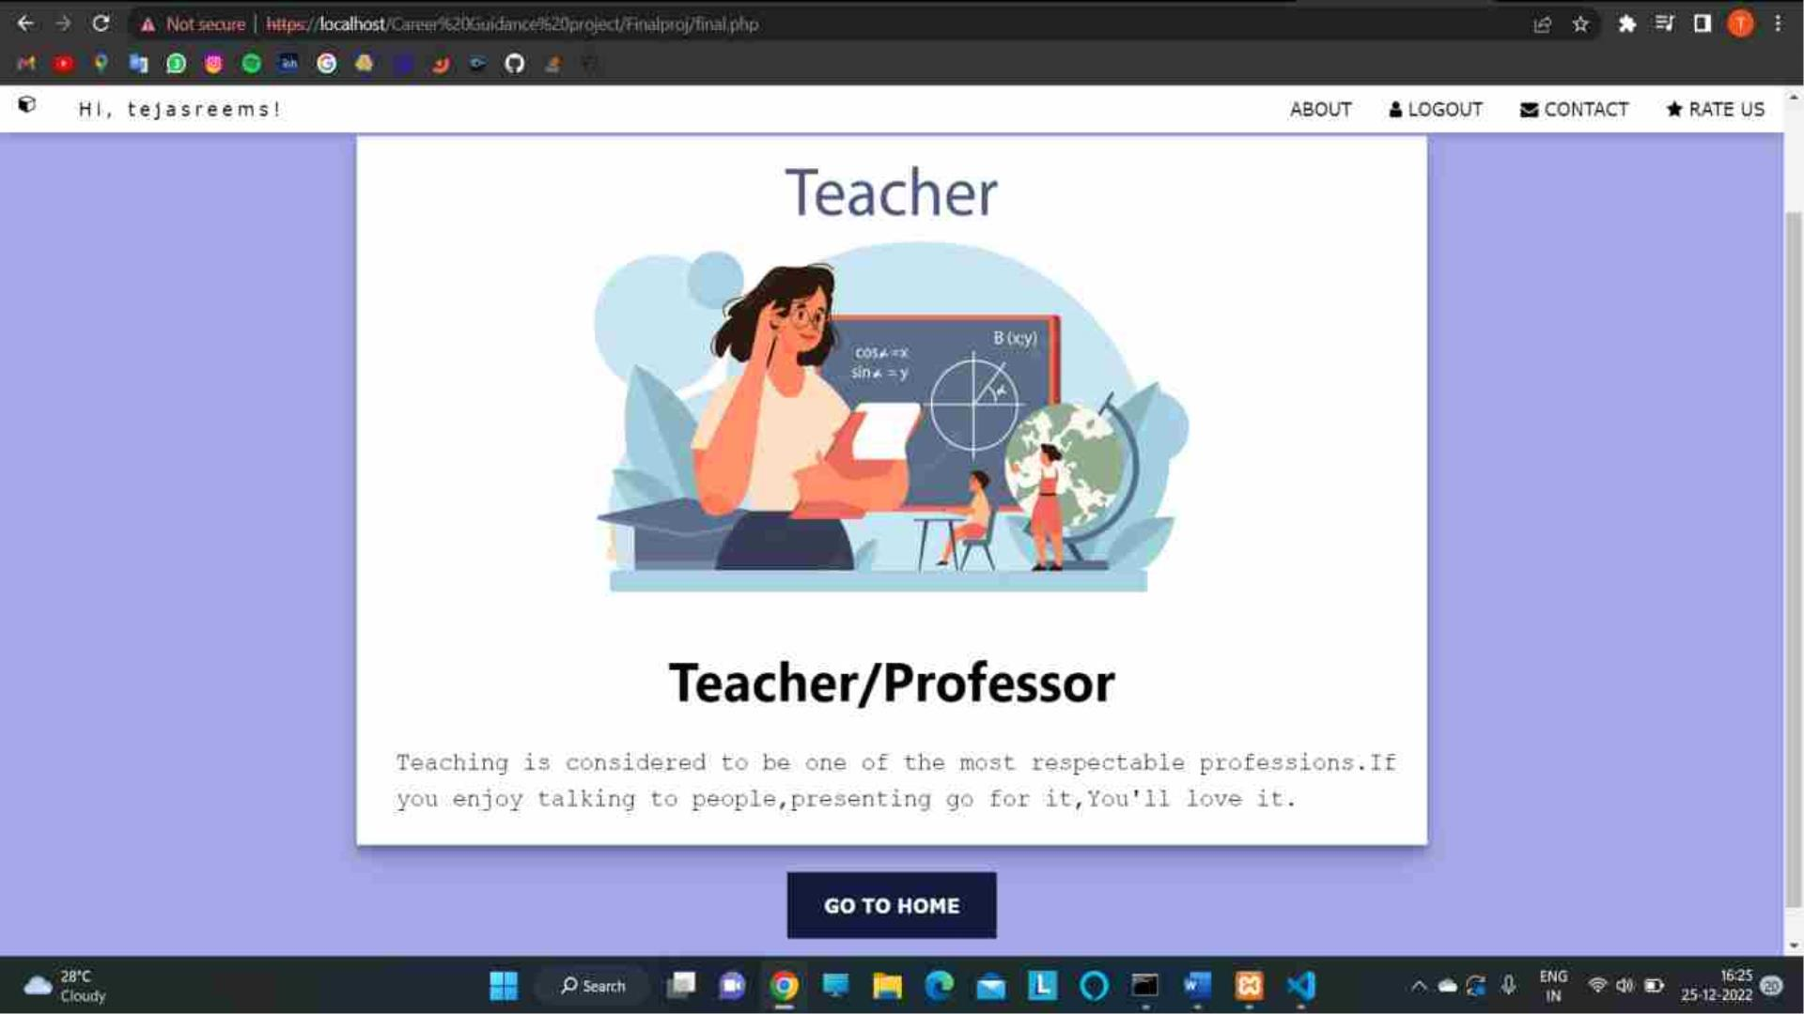

Slide 21
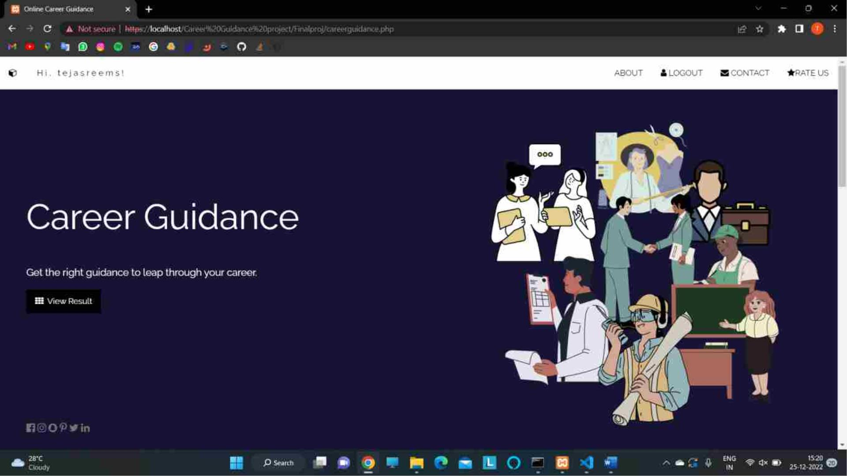

Slide 22
POSSIBLE CAREER
SUGGESTION
(BASED ON USER’S
ANSWERING)

Slide 23
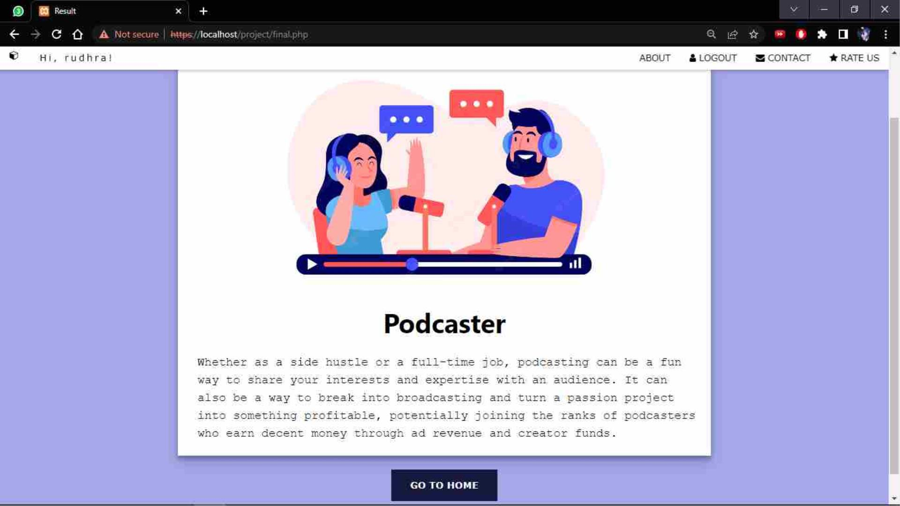

Slide 24
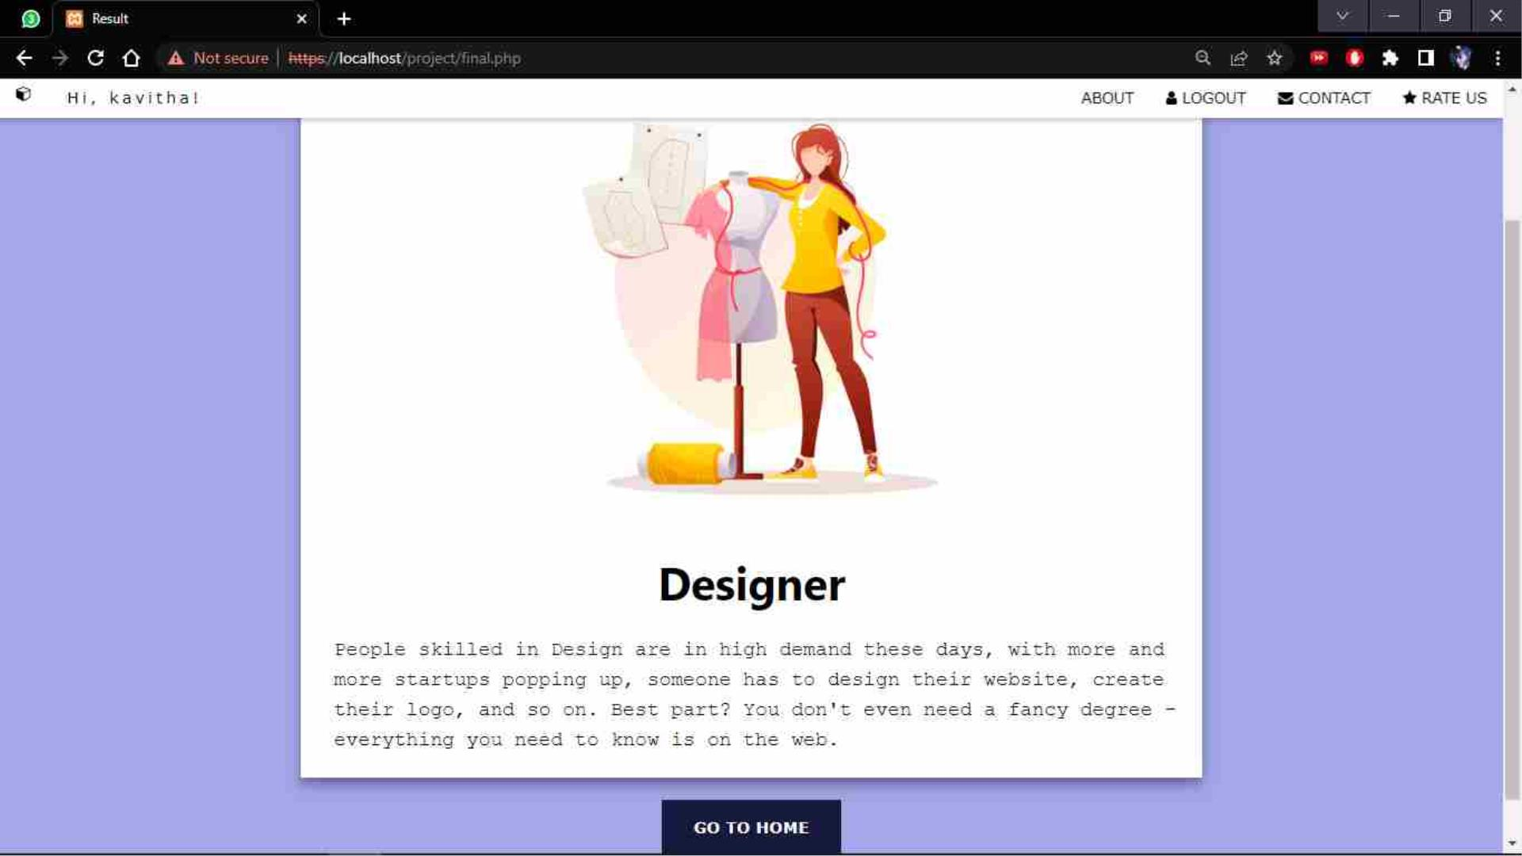

Slide 25
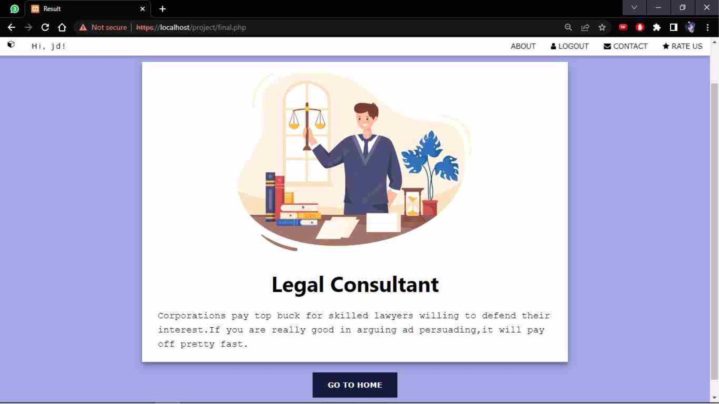

Slide 26
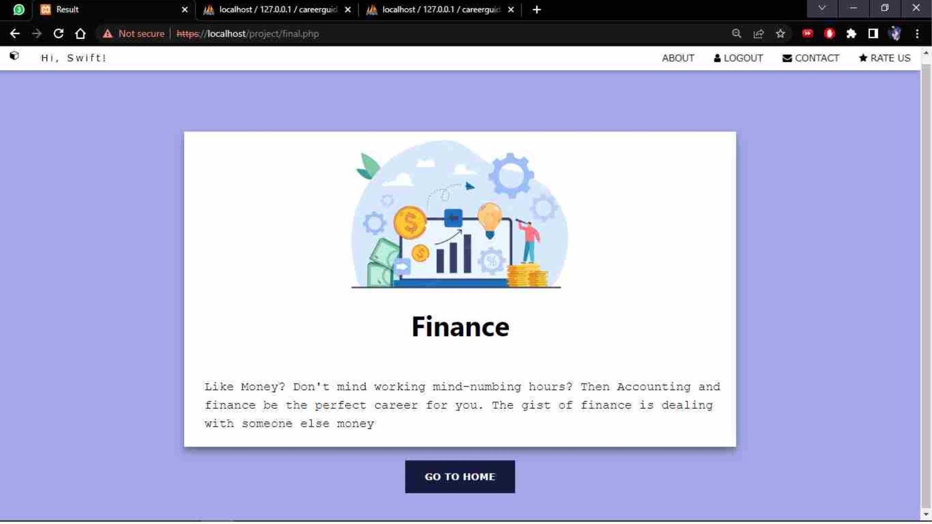

Slide 27
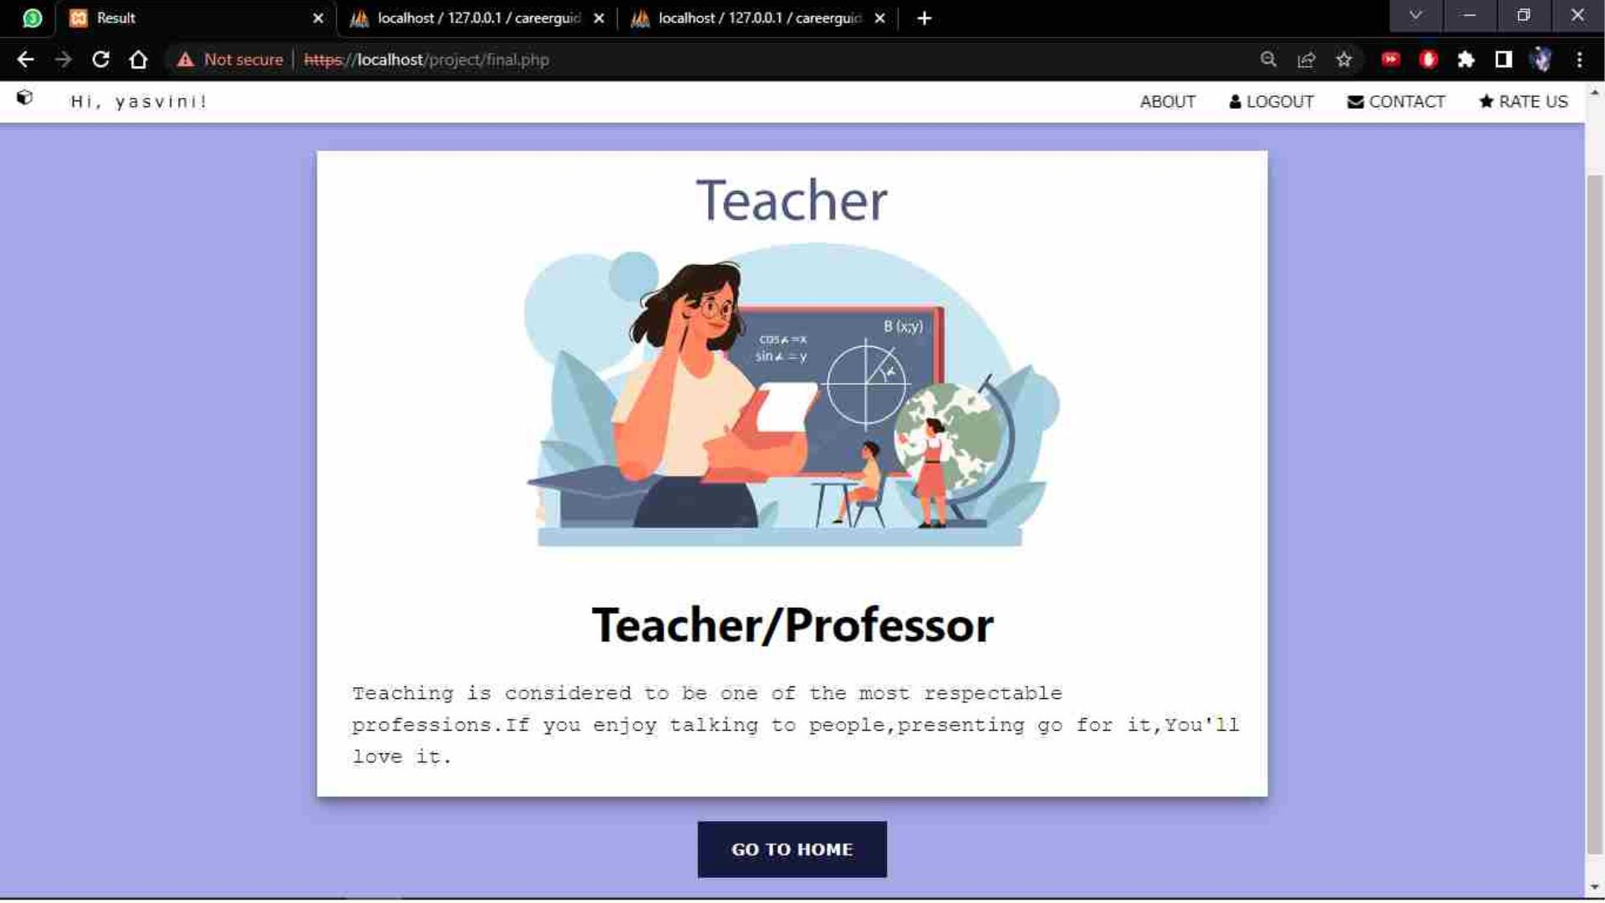

Slide 28
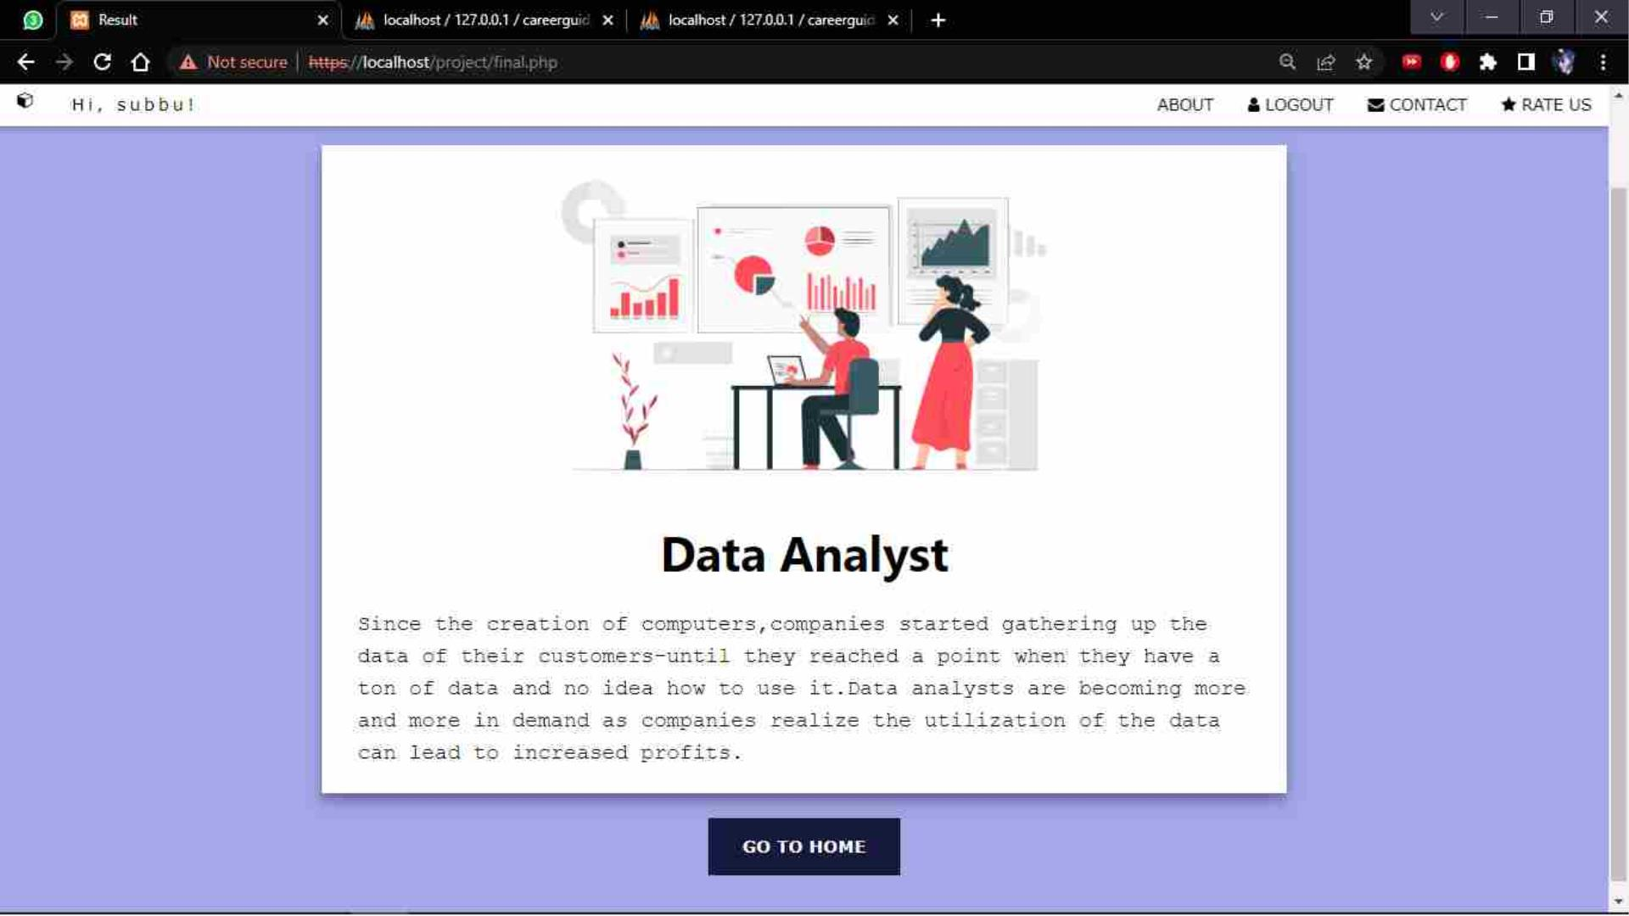

Slide 29
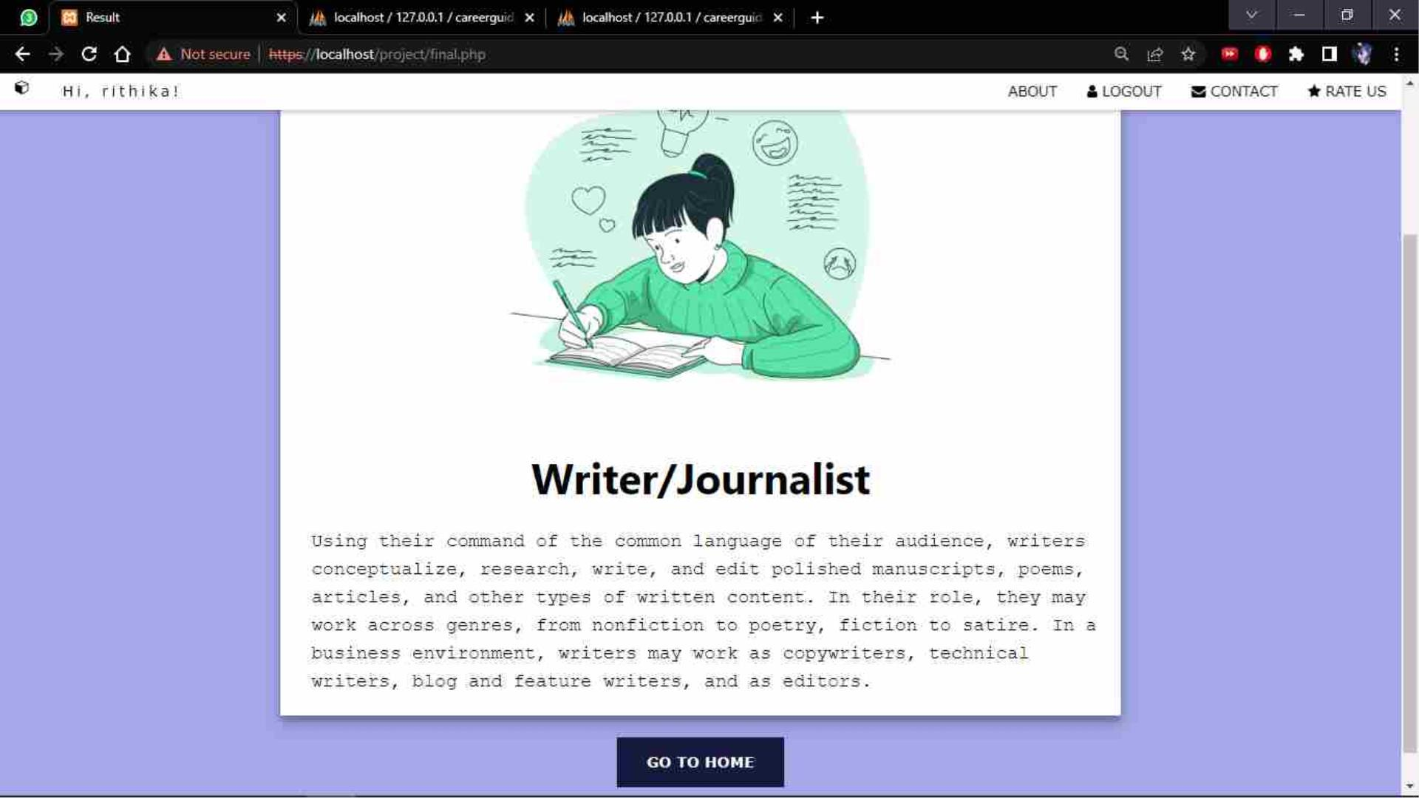

Slide 30
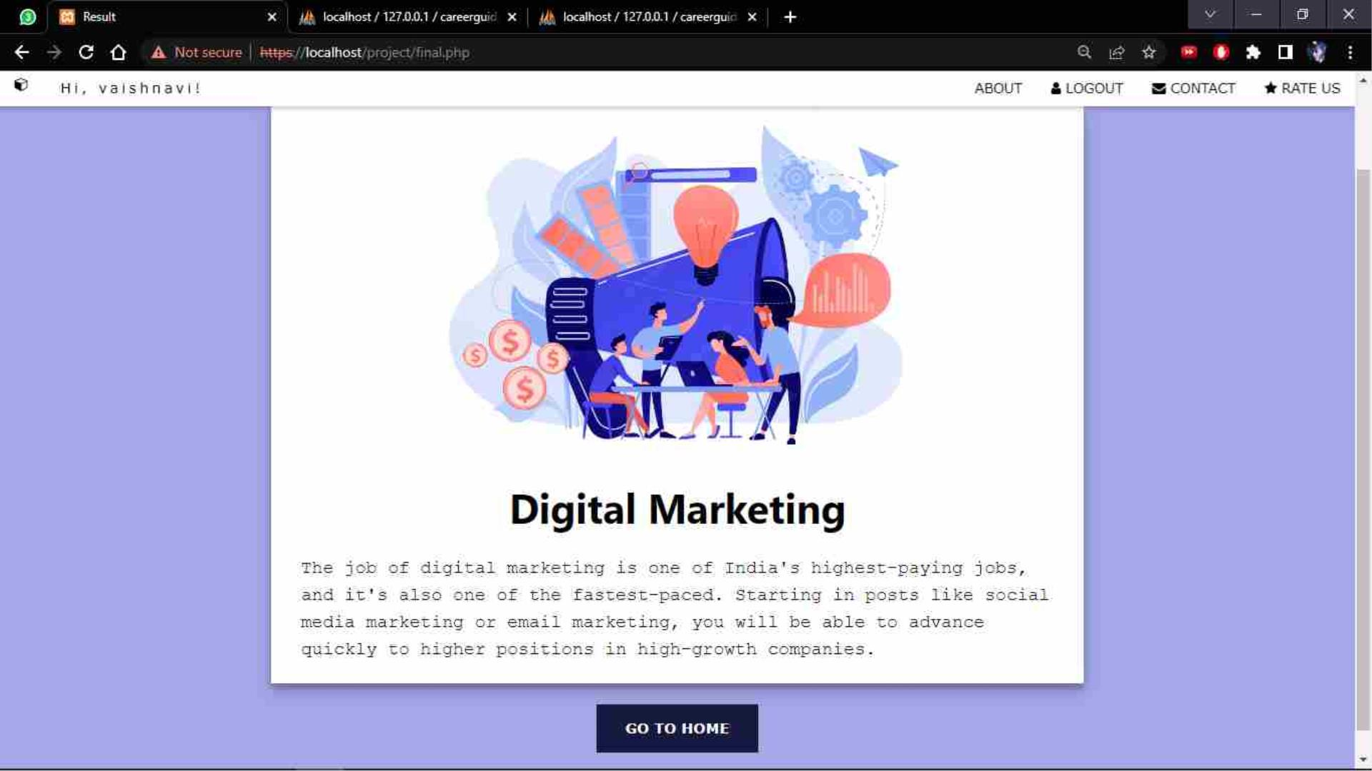

Slide 31
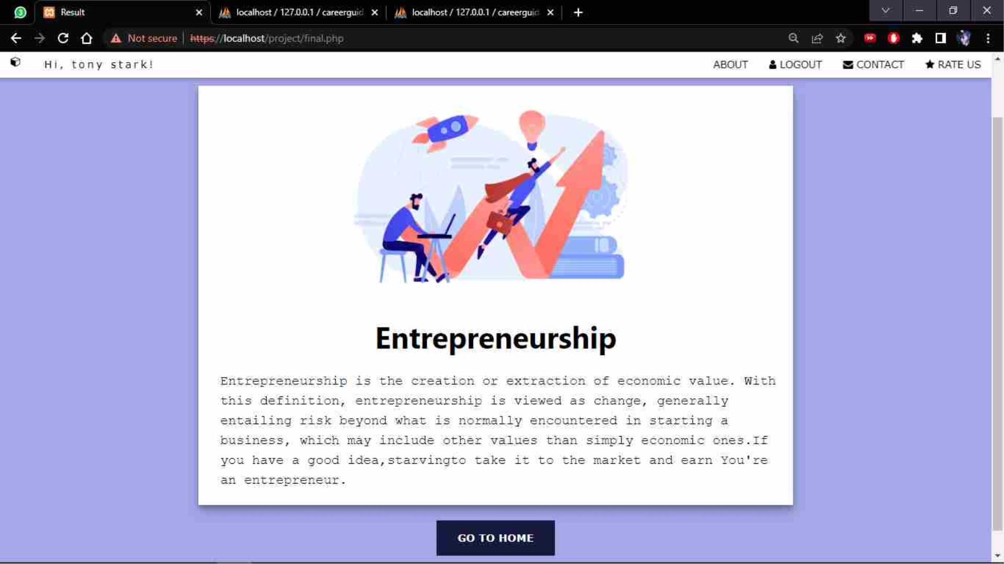

Slide 32
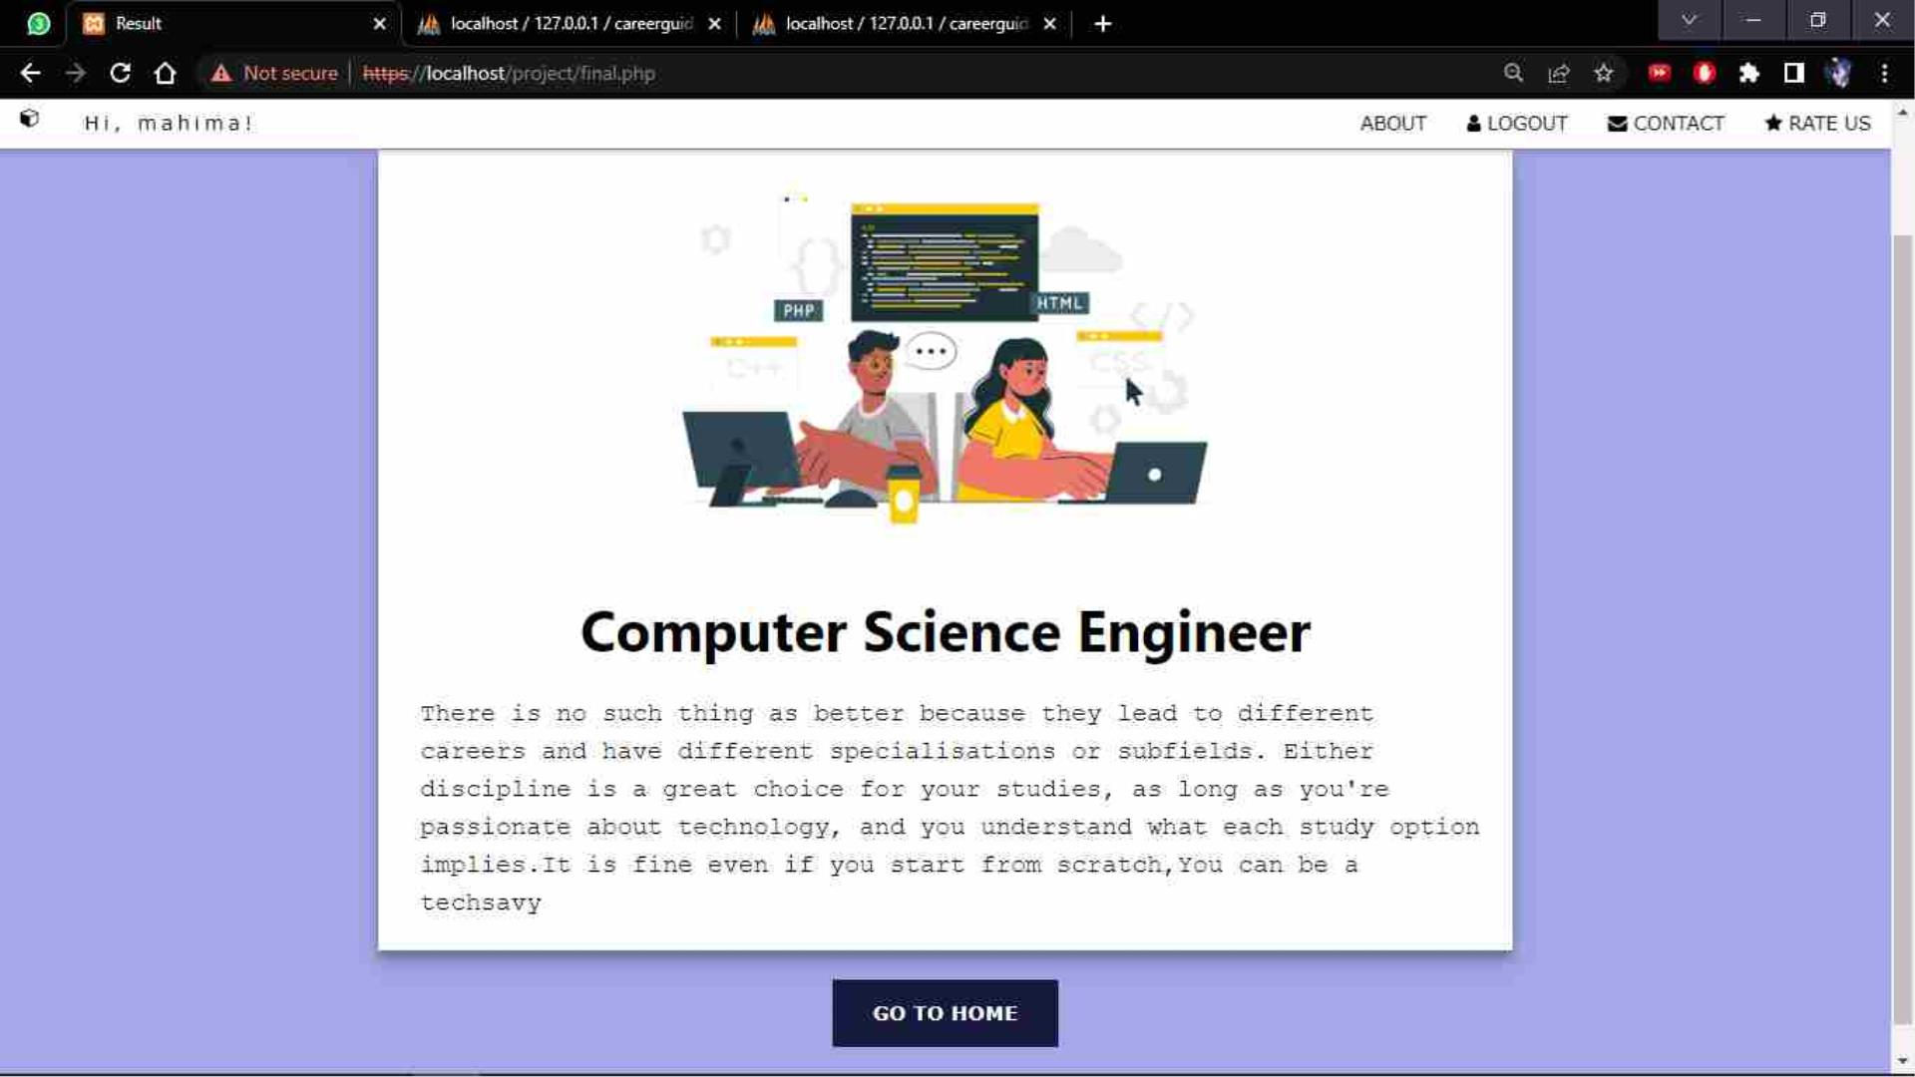

Slide 33
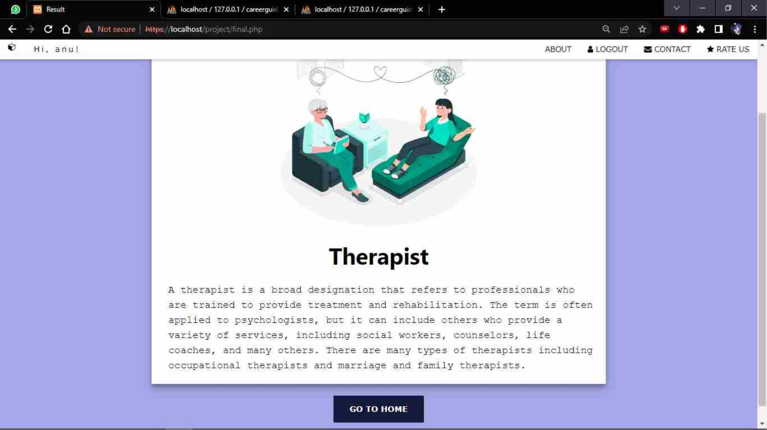

Slide 34
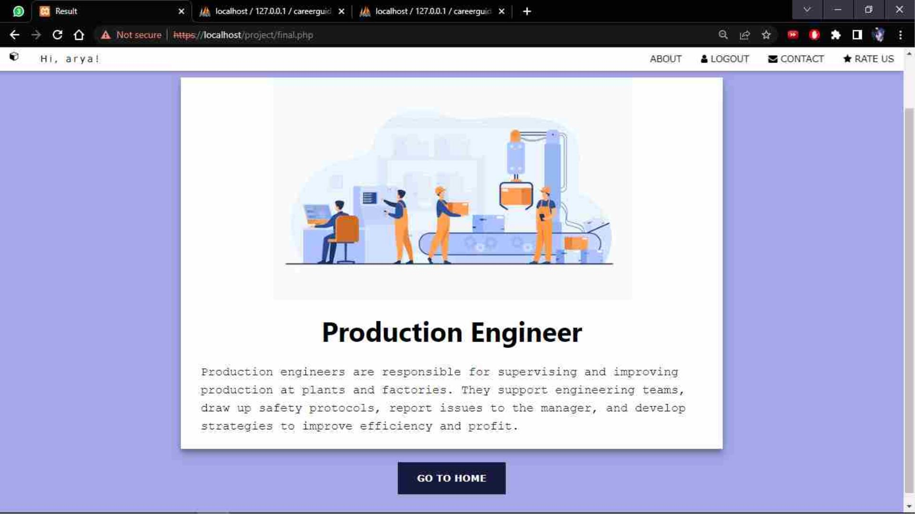

Slide 35
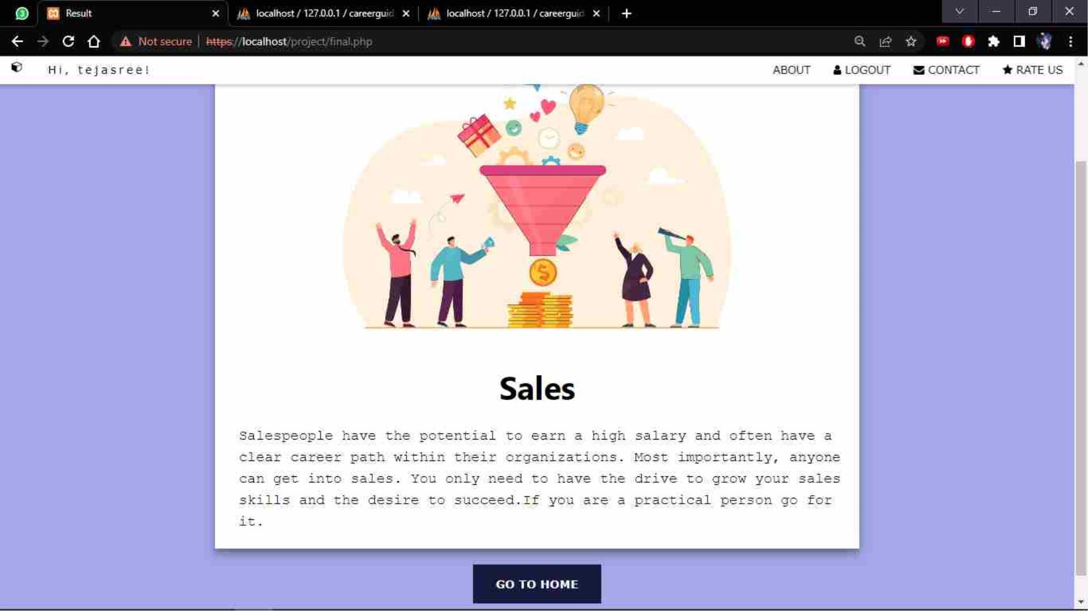

Slide 36
DATABASE TABLES

Slide 37
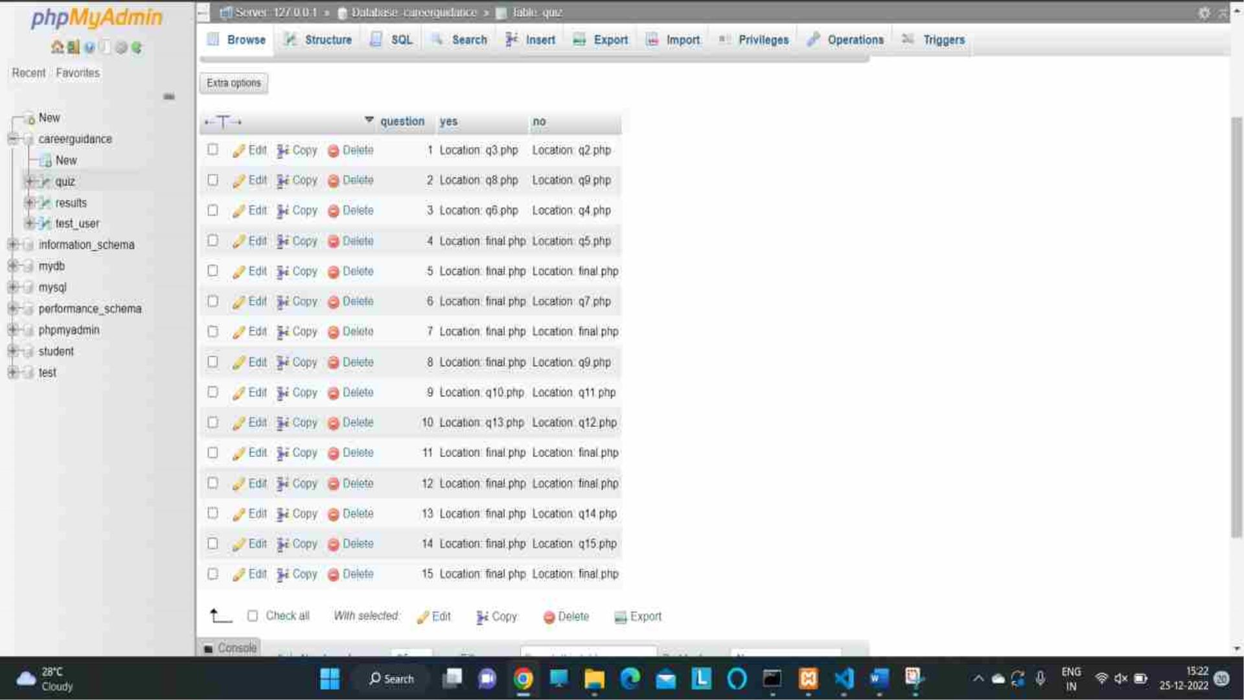

Slide 38
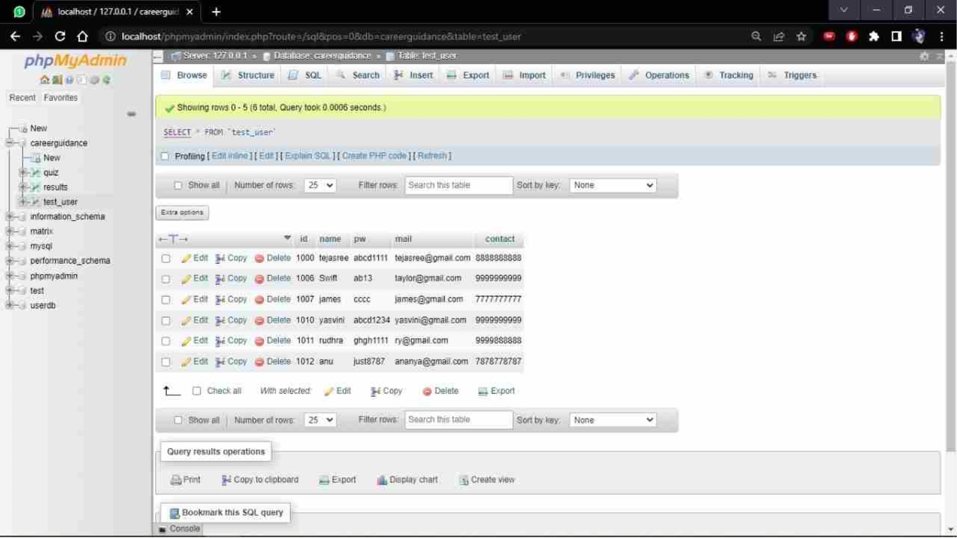

Slide 39
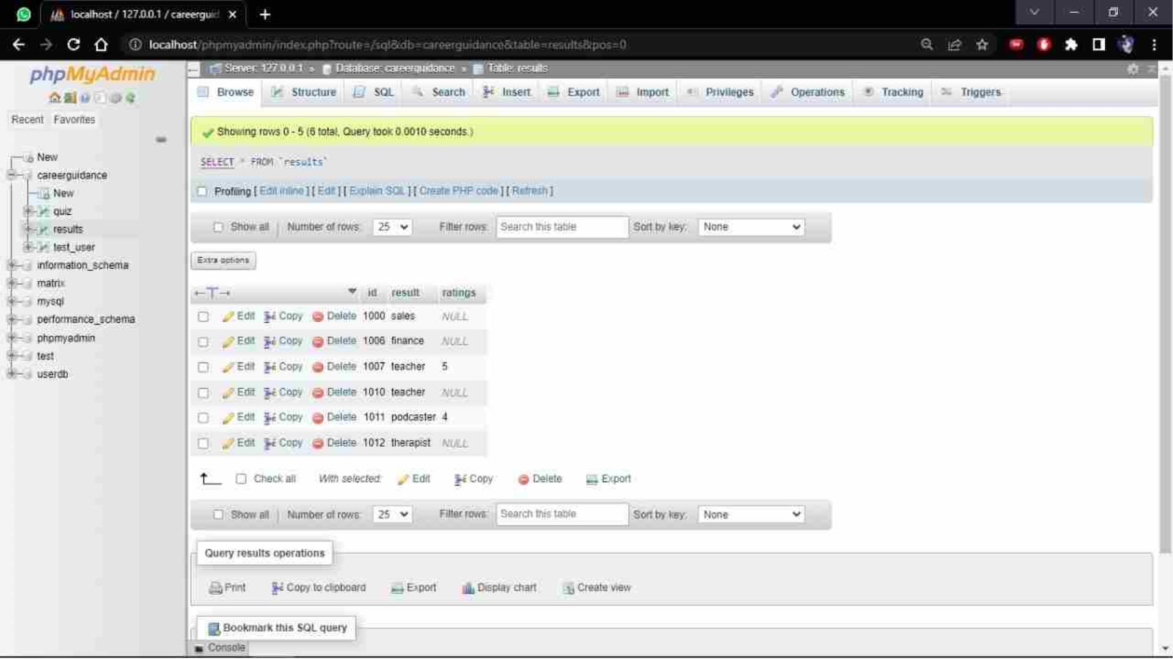

Slide 40
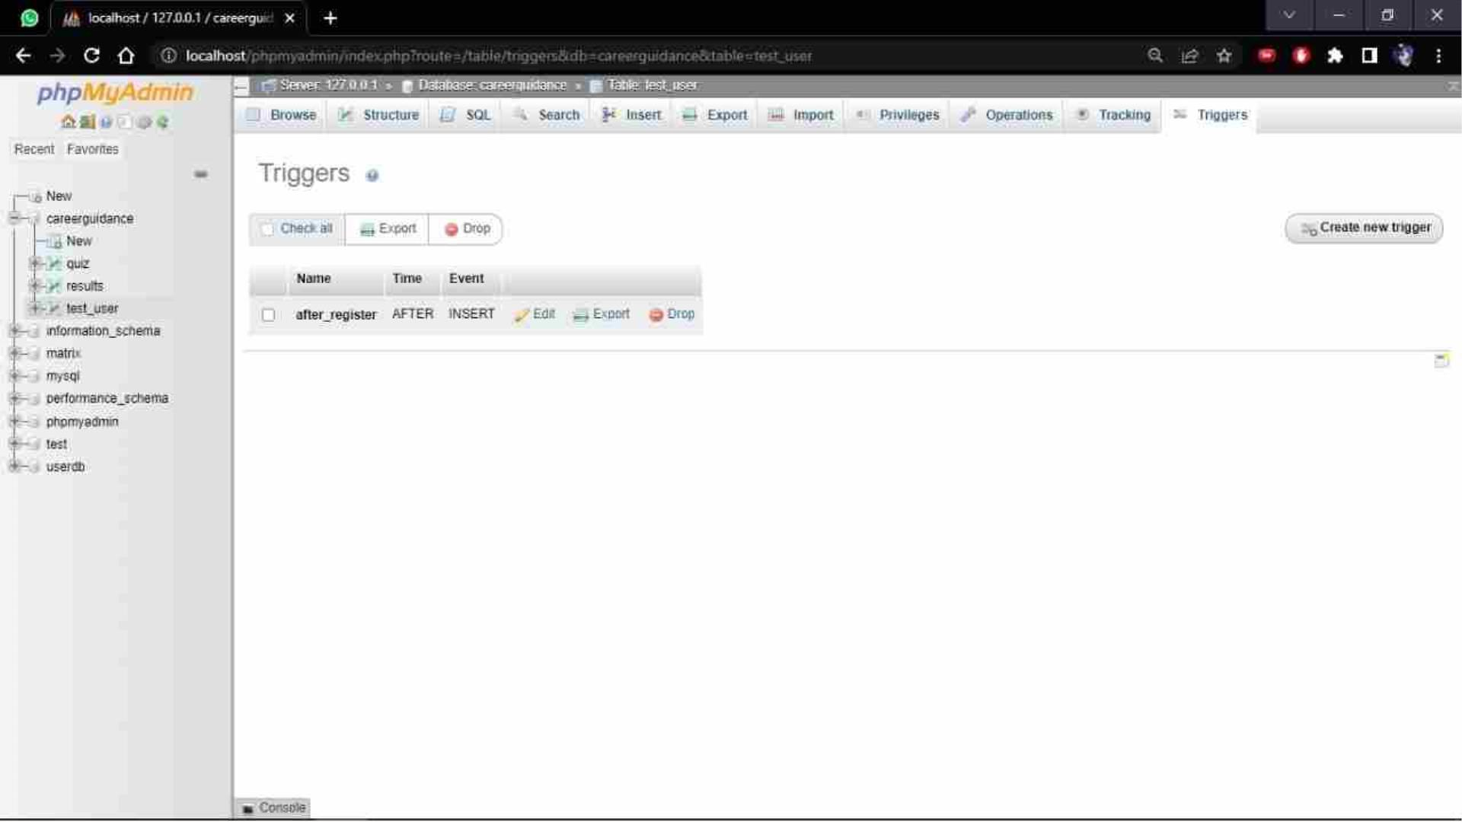

Slide 41
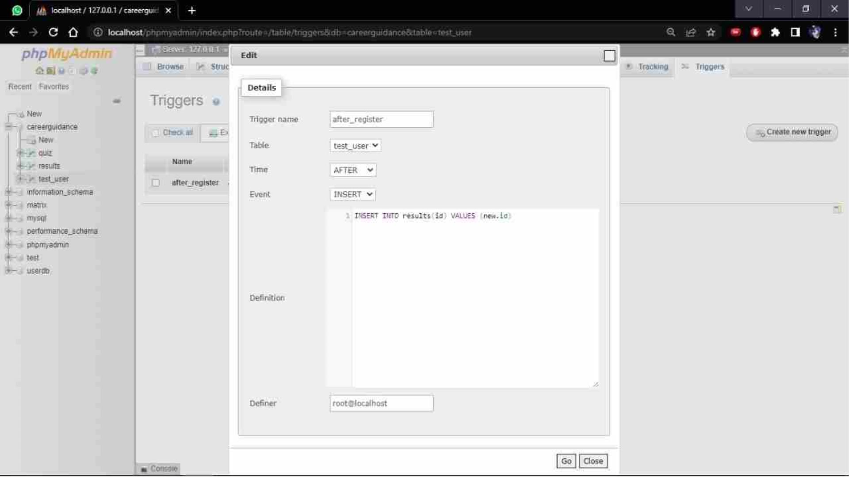

Slide 42

42
CONCLUSION
Thus the system we proposed provides perfect
career guidance for the freshers by making them
know what they love and what is going to excite
them in future when they took it up as their career.

Slide 43

THANK YOU
YASVINIPPRIYAA S K –
2021506126
TEJASREE M S – 2021506113
RUDHRA Y – 2021506076

